Slide 1
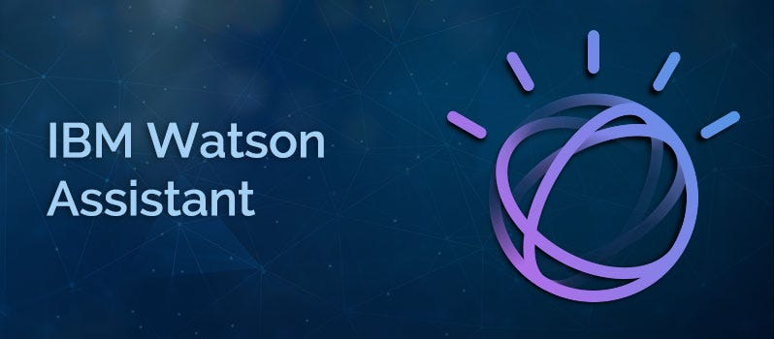
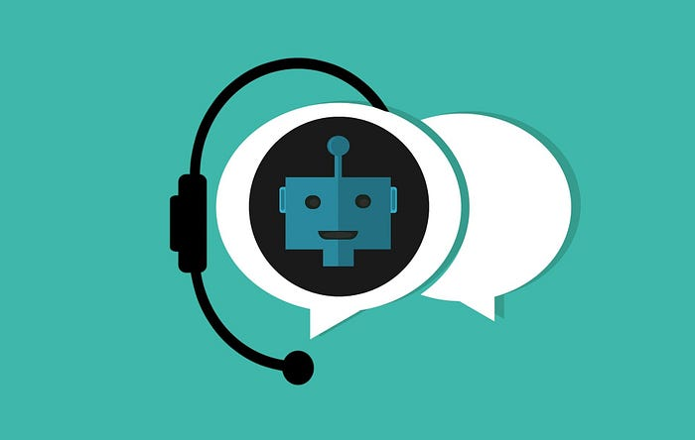
TITLE – “Book Recommendation Chatbot using IBM Watson Assistant ”
Name – Pranjal Shukla
Notes:
Title – Book Recommendation Chatbot using IBM Watson Assistant

Slide 2
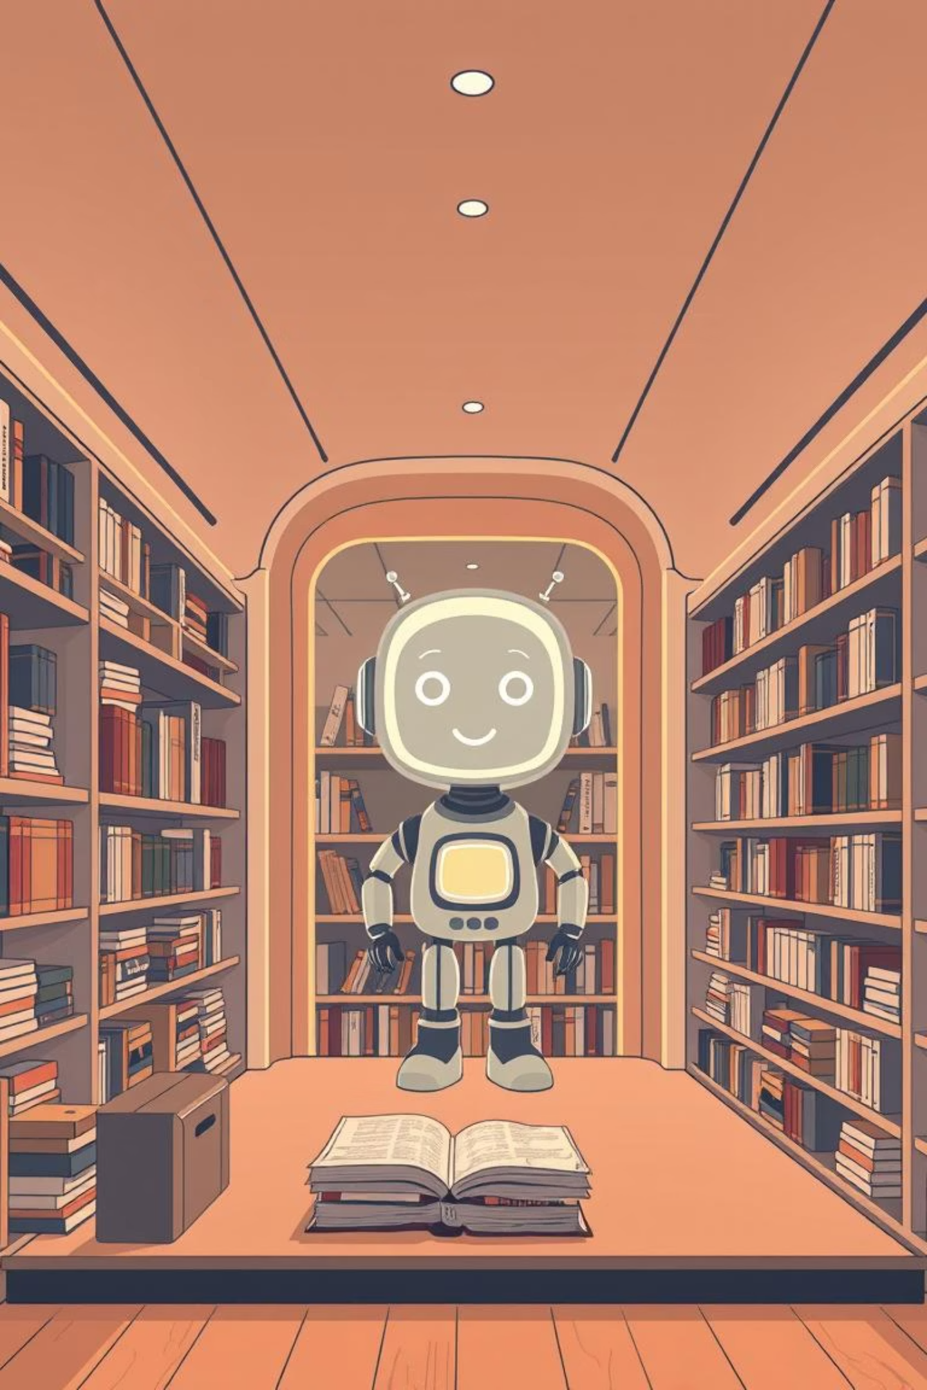
Chatbots: Your Intelligent Literary Companion
Discovering your next favourite read has never been easier!

Slide 3
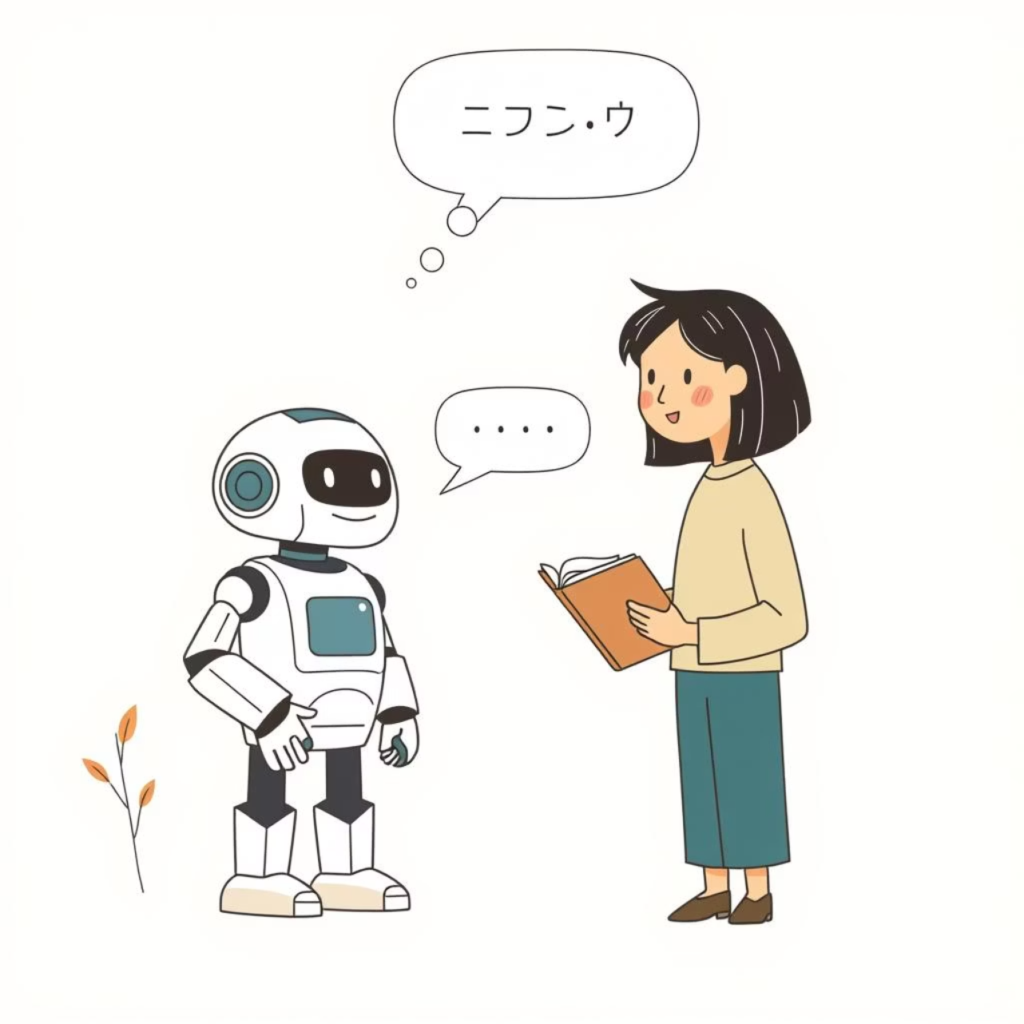
What are Chatbots?
Imagine a digital friend always ready to chat. That's a chatbot! These AI-powered programs simulate human conversation, designed to understand your queries and respond intelligently.
Digital Conversationalist: AI-powered programs simulating human conversation.
Beyond Basic Bots: Using Natural Language Processing (NLP) and Machine Learning (ML).
Accessible & Versatile: Found on websites, apps, and messaging platforms.

Slide 4
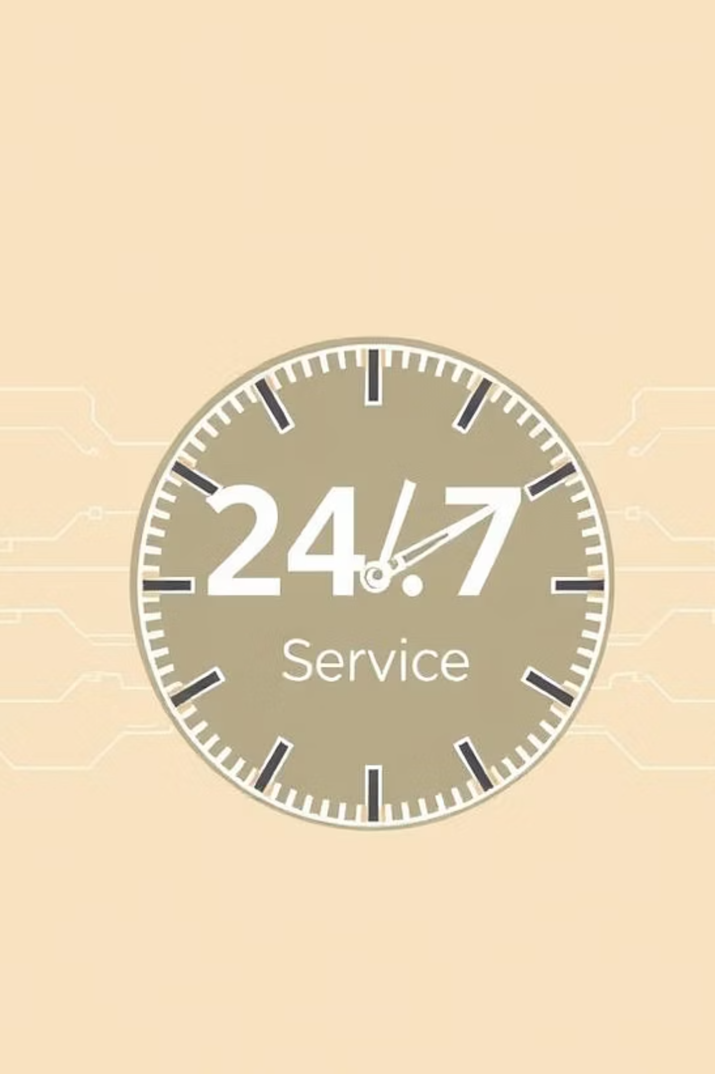
Why Chatbots Matter?
24/7 Availability
Enhanced Customer Experience
Instant support and information, anytime, anywhere.
Personalised interactions and tailored recommendations.
Cost-Effective Solution
Automating tasks and reducing operational costs.

Slide 5
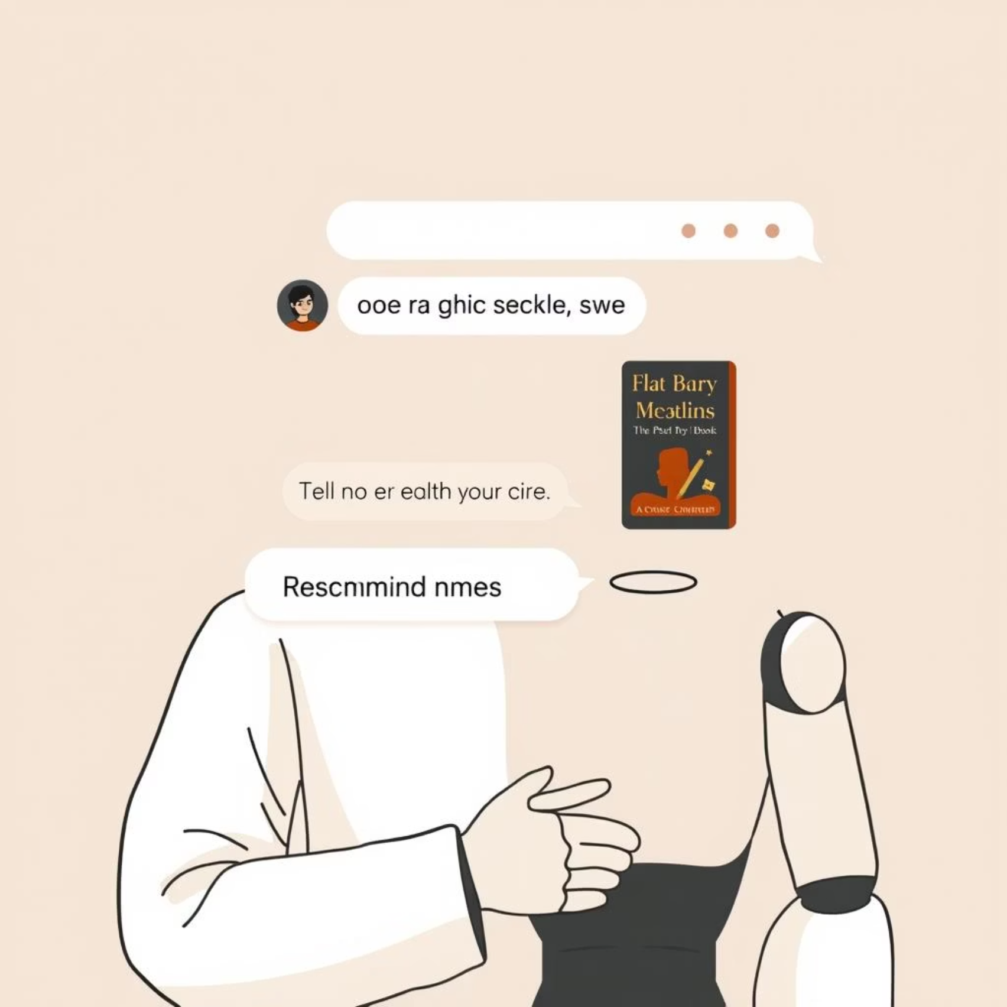
How Chatbots Work: Your Literary Assistant
Example: You ask, "Recommend a good fiction book." The chatbot analyzes your request and suggests a title based on your past preferences or popular choices, acting as your smart literary guide.
Input Analysis
The chatbot receives and analyzes your query.
Data Processing
Accesses its knowledge base to find the best response.
Output Generation
Provides a relevant answer or recommendation.

Slide 6




Benefits of Using a Chatbot for Book Recommendations
Book Recommendations:
Fiction:
"Pride and Prejudice" by Jane Austen
Personalised Recommendations
Non-Fiction:
Tailored suggestions based on your reading history and preferences.
"Sapiens: A Brief History of Humankind" by Yuval Noah Harari
Biography:
Genre Exploration
"Steve Jobs" by Walter Isaacson
Discover new books across various genres, from fiction to horror.
Self-Help:
"The 7 Habits of Highly Effective People" by Stephen Covey
Instant Access
Horror:
Receive recommendations and information immediately.
"It" by Stephen King
Romance:
Always Available
"The Notebook" by Nicholas Sparks
Get book suggestions anytime, anywhere, on demand.

Slide 7
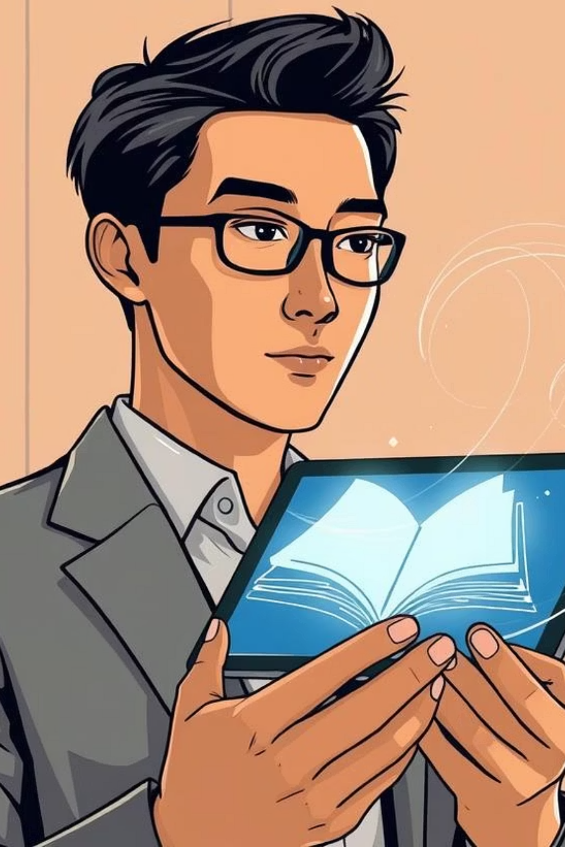
Conclusion: Embrace the Future of Reading
Chatbots are revolutionising how we discover and engage with books. They offer a convenient, personalised, and always-available resource for readers. Start exploring the world of books with your intelligent literary companion today!

